Slide 1
RxJS
Reacting to Actions: Examples
Lecture 8
By James(Jin) Wang
12/05/2021

Slide 2
Outline
React to selections
React to errors
React to add operations

Slide 3
React to selections
  React to selections: Data Stream
  Demo: react to selections Data Stream

Slide 4
React to selections
  React to selections: Action Stream
  Demo: react to selections Action Stream

Slide 5
React to errors
  React to errors
  Demo: react to errors

Slide 6
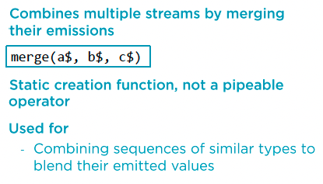
React to add operations
  RxJS Creation Function: merge

Slide 7
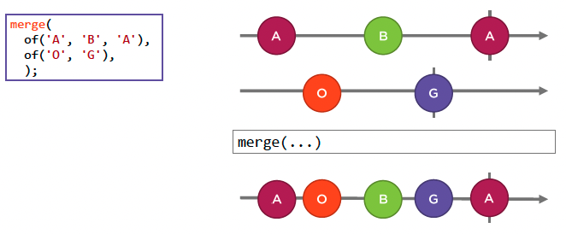
React to add operations
  Marble Diagram: merge

Slide 8
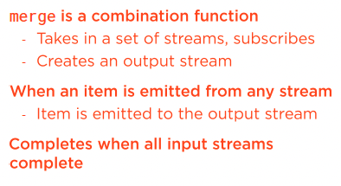
React to add operations
  RxJS Creation Function: merge

Slide 9
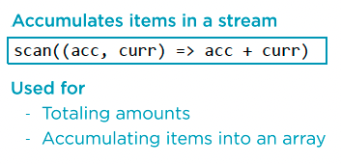
React to add operations
  RxJS Operator: scan

Slide 10
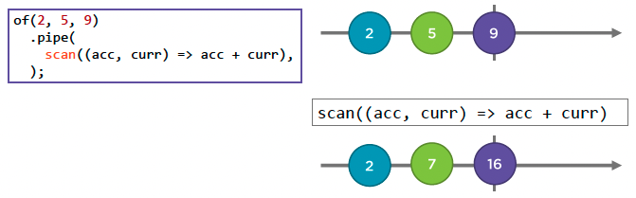
React to add operations
  Marble Diagram: scan

Slide 11
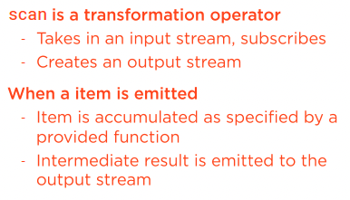
React to add operations
  RxJS Operator: scan

Slide 12
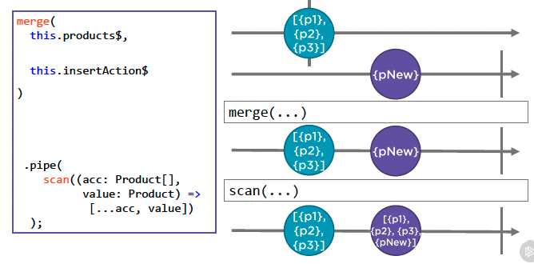
React to add operations
  Reacting to an Add Operation
  Demo: react to add operation

Slide 13
Summary

Slide 14
Assignment

Slide 15
Self Study
  RxJS: The Big Picture
  https://app.pluralsight.com/library/courses/rxjs-big-picture

